Slide 1

Software requirements (swr302)
Improving your requirements processes (chapter 31)

Slide 2
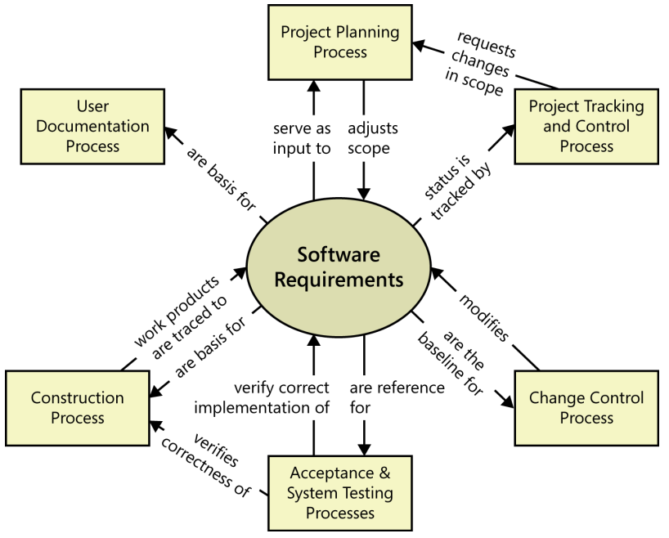
How requirements relate to other project processes

Slide 3
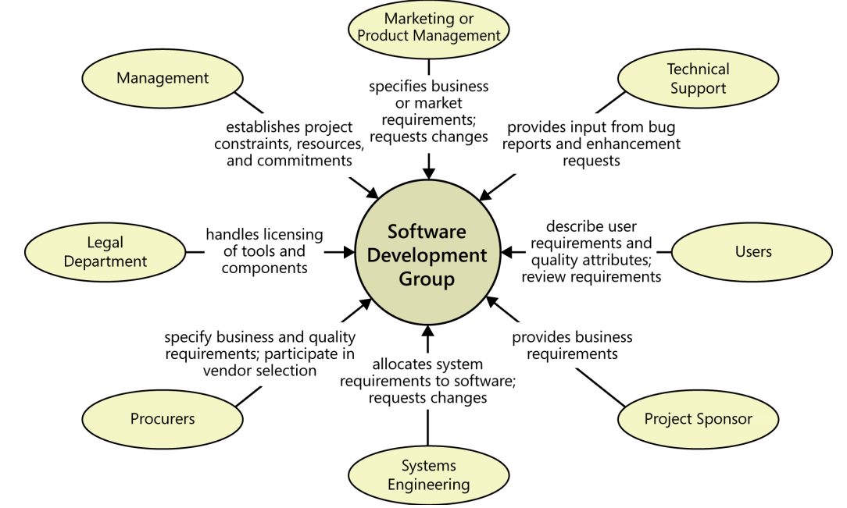
Requirements & various stakeholder groups

Slide 4
Gaining commitment to change Some forms of resistance that you might encounter
People who are already too busy to get their project work done don’t think they have time to invest in adopting better practices. But if you don’t invest that time, there’s no reason to expect the next project to go more smoothly than the last one.
A change control process might be viewed as a barrier thrown up by development to make it harder to get changes made. In reality, it is a structure, not a barrier. It permits well-informed people to make good business decisions and to communicate those decisions. The software team must ensure that the requirements change process really does work. If new processes don’t yield better results, people will naturally find ways to work around them.
Some developers and managers view writing and reviewing requirements as bureaucratic time-wasters that delay the “real work” of coding. If you can explain the high cost of continually rewriting the code while the team tries to figure out what the system should do, developers and managers will better appreciate the need for good requirements. Overlooked requirements can reduce profitability during the operational lifetime of a software product, because effort must continually be invested in producing upgrades

Slide 5
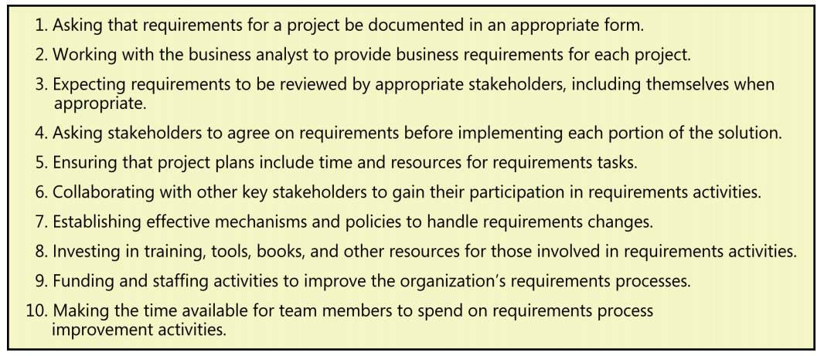
Gaining commitment to change 10 signs that your organization’s management is truly committed to excellent requirements processes

Slide 6
Fundamentals of software process improvement
Process improvement should be evolutionary and continuous
People and organizations change only when they have an incentive to do so
Process changes should be goal-oriented
Treat your improvement activities as mini-projects.

Slide 7
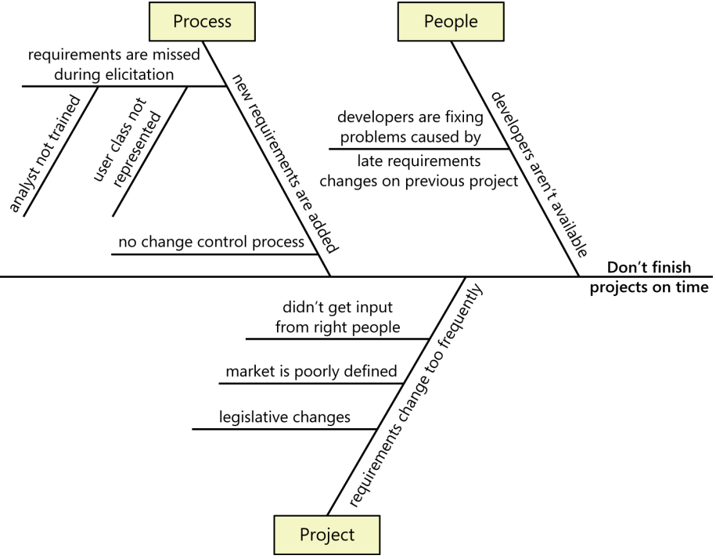
Root cause analysis
Root cause analysis seeks to identify the underlying factors that contribute to an observed problem, distinguishing symptoms from their causes

Slide 8
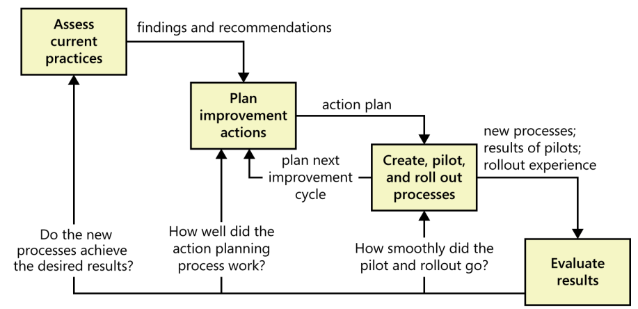
The process improvement cycle

Slide 9
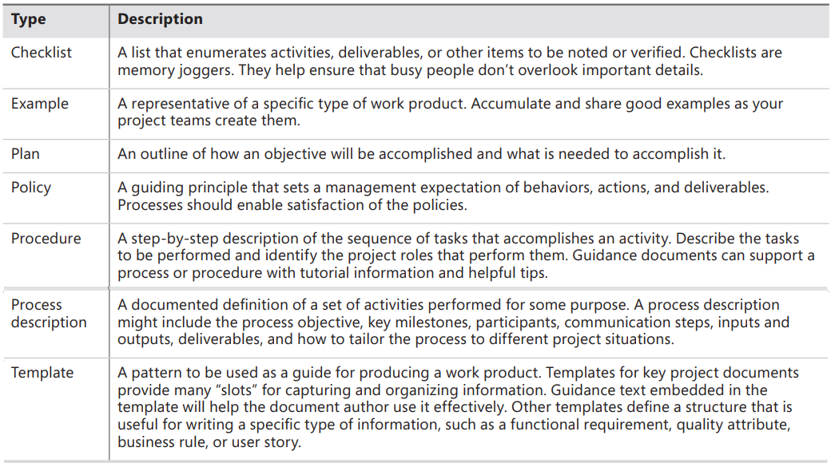
RE process assets

Slide 10
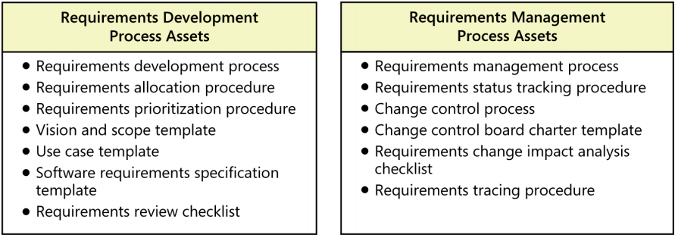
RE process assets

Slide 11
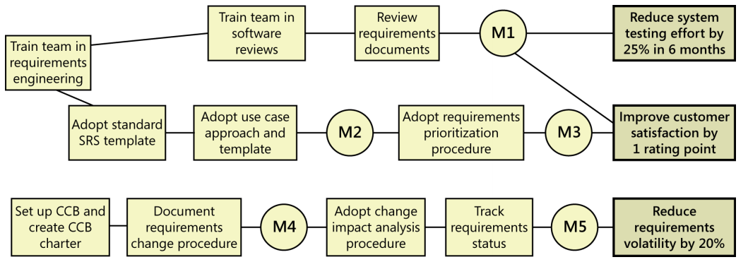
Creating a requirements process improvement road map

Slide 12


